Slide 1
Portfolio Optimization using Mean-Variance optimization with price prediction driven by historical data
Ziyu Chen, Kai-Lun Liu, Hongtao Shi, Ziyu Wang, Xinshou Zheng,

Slide 2
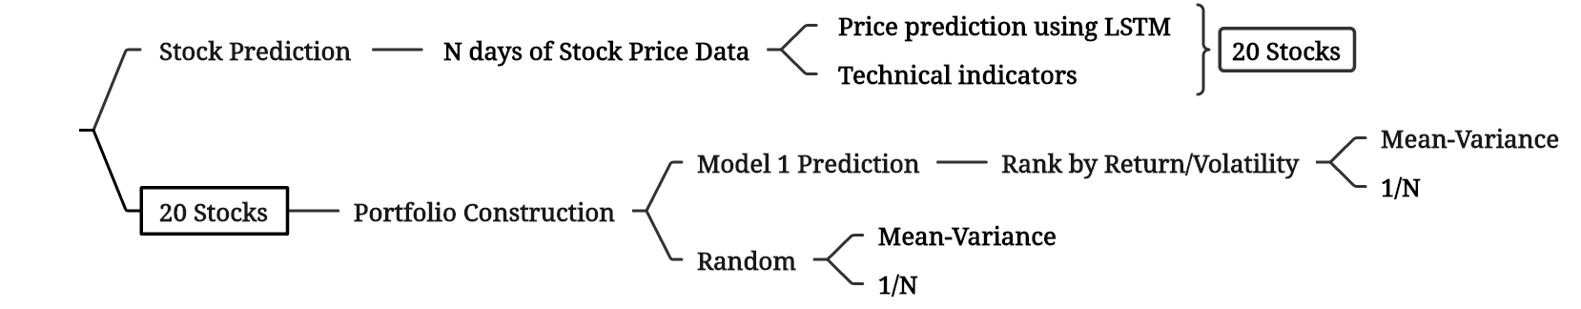
Project Outline
Project Outline

Slide 3
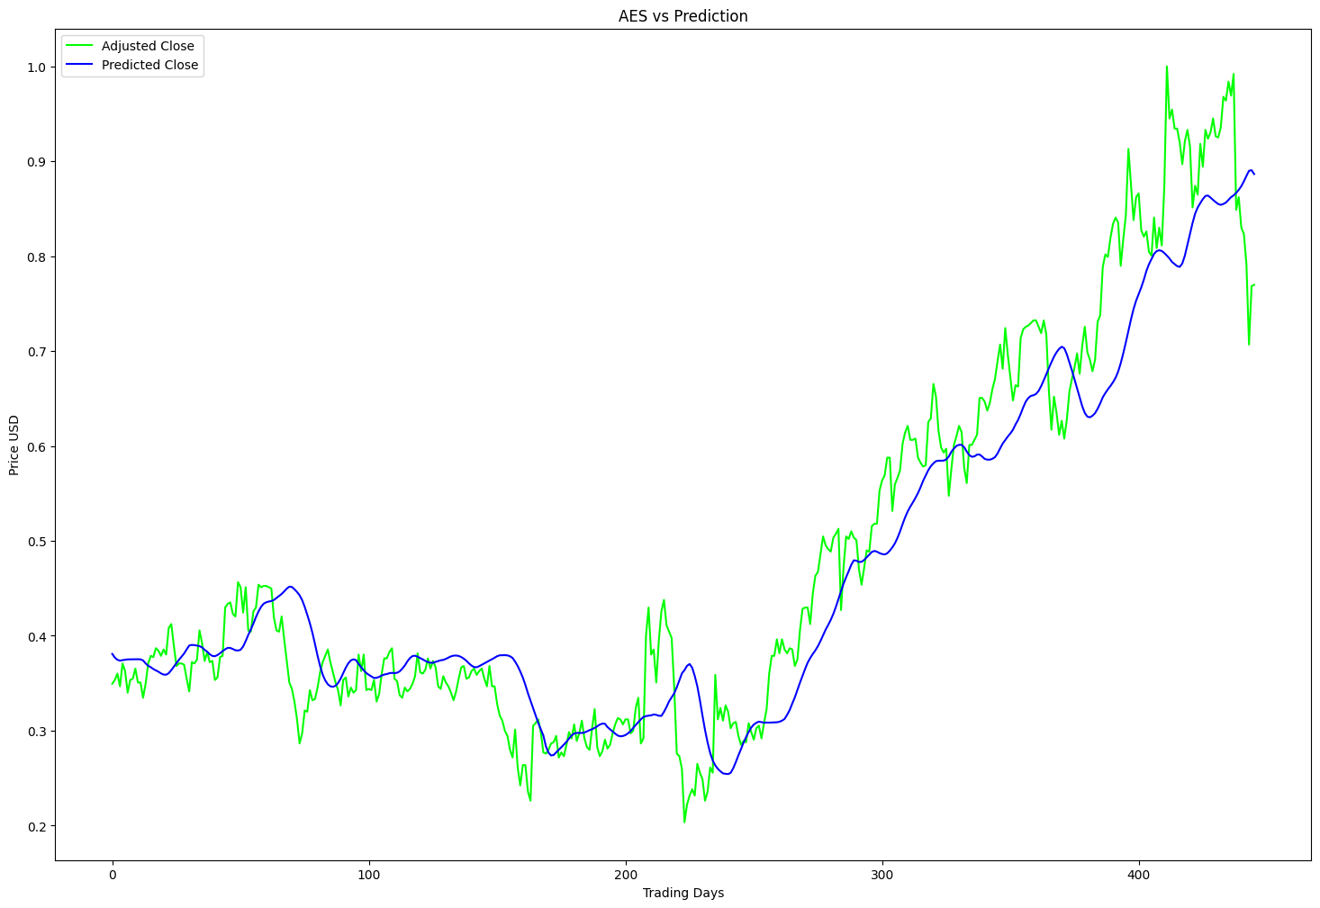
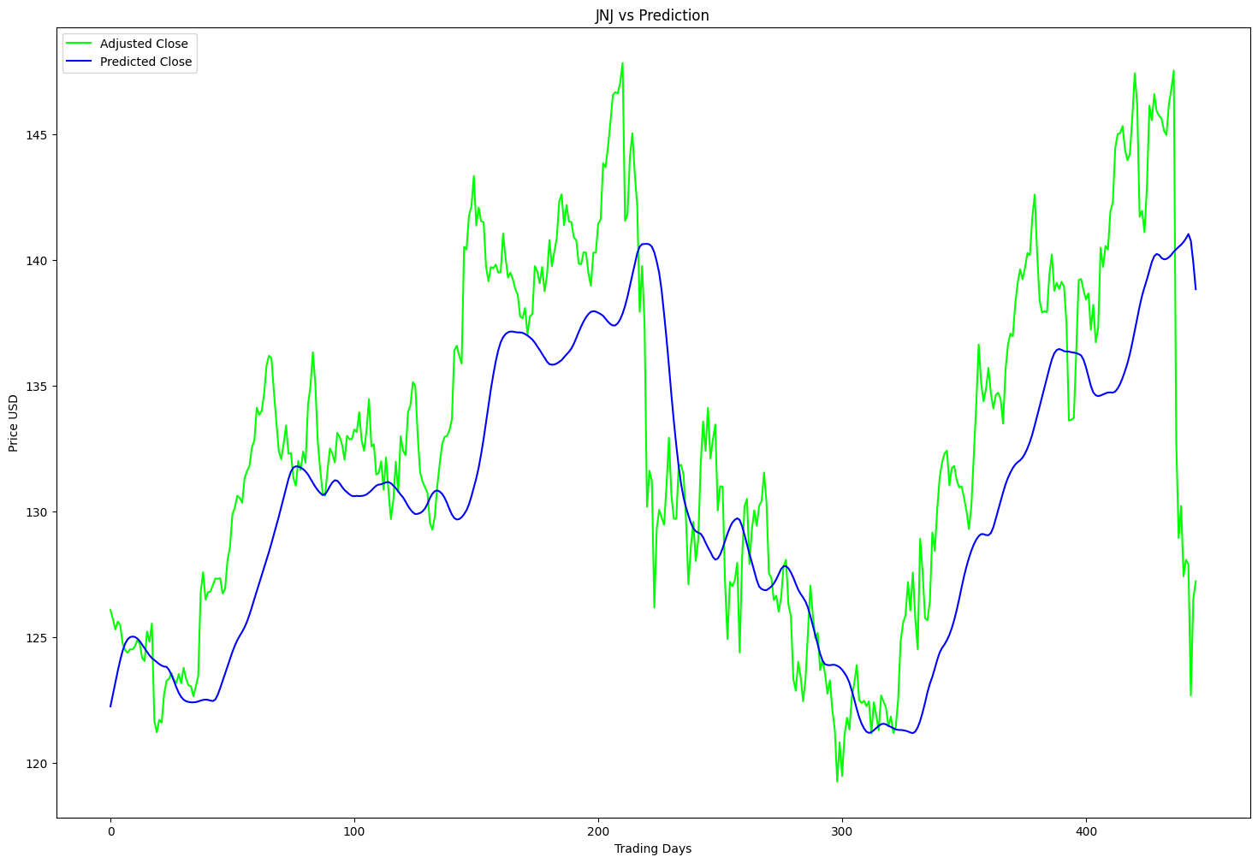
Stock Prediction
randomly pick 20 stocks:
['AES', 'UNH', 'AAPL', 'PG', 'PLD', 'DLR', 'BAC', 'TMO', 'JNJ', 'DUK', 'NKE', 'CVS', 'SWK', 'SHW', 'MSFT', 'DISH', 'GIS', 'MA', 'CAG', 'BBY']

Slide 4
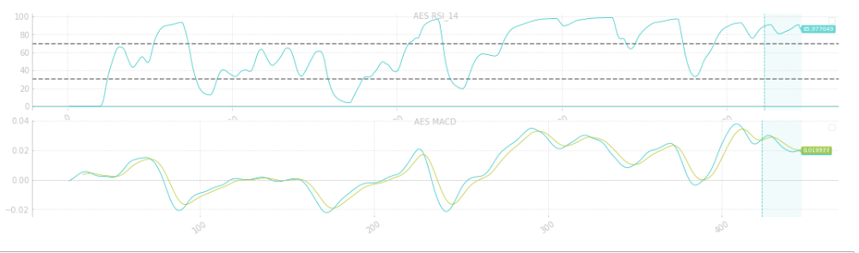
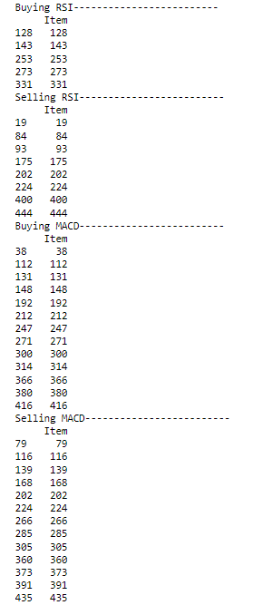
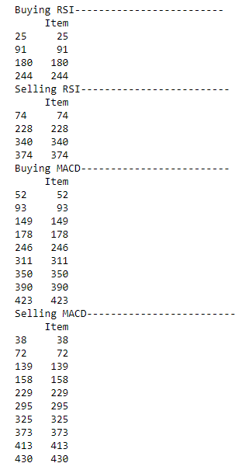
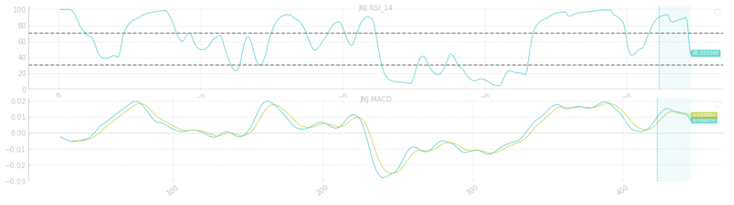
Stock Index & Buying / Selling points

Slide 5
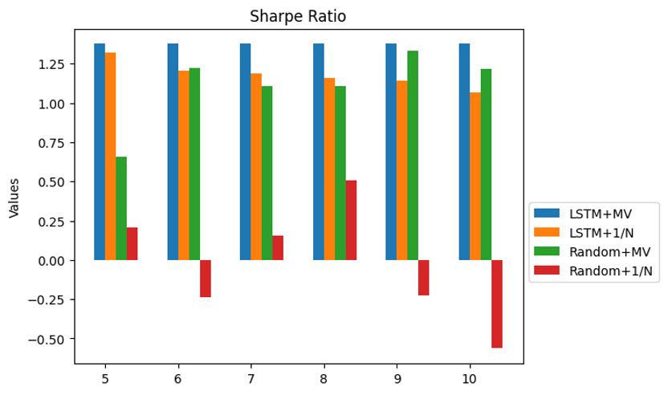
Portfolio Optimization-Rank by Return

Slide 6
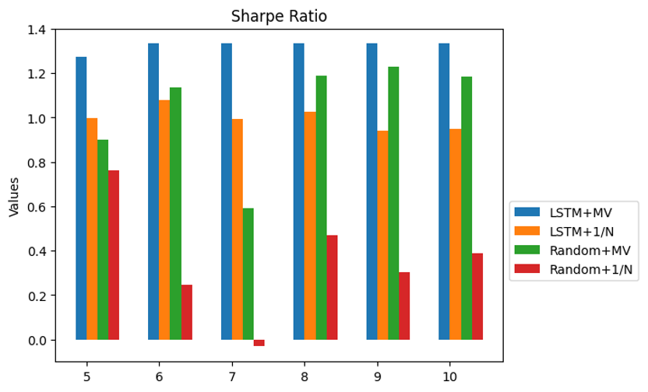
Portfolio Optimization-Rank by Volatility

Slide 7
Thank you!

